Slide 1


Lorbek Cars Showroom Online System
Group M1 – Auspal Systems
Salina Darai – K210370
Neshaan Kumal – K210054
Kshitiz Acharya – K201032
Santosh Thapa – K220309
Presentation Date: 20/12/2023

Slide 2
Project Ideas
Create an easy to use Online Application System.
Also will give an ideas of Users and Admin Module.
This presentation will give an ample overview of the system’s design and features.

Slide 3

Background
Lorbek aims to use Application System to keep things organized and reduce errors.
Use automation to make data more accurate, processes smoothly, and to achieve the overall experience for customers.
This project considers challenges and opportunities in the car industry, aiming to make the showroom strong and able to adapt to changes in the market.

Slide 4
Objectives and Purpose
Introduce an online application management system
Utilize technology to give customers a better shopping experience
Provides customer to view cars with filters
Loan request option with price calculator
AI chatbot feature
Online payment options
Customer Dashboard and Inventory management
Automatic Report generation

Slide 5
Scope and Project Deliverables
Aim: Create an online application management system to manage the details of Cars, Customers, Insurance, Payment and Loan.
Fully functional and user-friendly User interface designs.
Generate reports on Customers, Cars, Payment.
Registration and Login system
Database storage system to manage details in real time
Customer can search cars with advance filter options
Developing solid and flexible online management system

Slide 6
Our Team
Salina Darai
Neshaan Kumal
Project Manager
Kshitiz Acharya
DB Admin/Developer
Santosh Thapa
Web Programmer
UI Designer + Incident Manager
- Background of study
- Functional requirements
- DFD level 0
- DFD level 2
- Sequence Diagram
- User Interface Design
- Assumptions
- Non-Functional requirements
- Project Deliverables
- DFD level 1, DFD level 2
- Entity Relationship Diagram
- User Interface Design
- Purpose & Objectives
- Use case diagram
- DFD level 2
- Implementation of data encryption and Anonymization
- User Interface Design
- Scope and limitations
- System architecture design
- DFD level 2
- User Interface Design
- Data protection and impact assessment

Slide 7
Functional Requirement
Admin
Admin Login
View Dashboard
Create Scheduling Tasks
View Vehicle Inventory
View Available Vehicles
View Stock Levels
Generate Notification Alert
Manage order
View Bookings
View Bookings
Manage users
Manage Accessories
Manage Shipping
Maintain Records
Manage Payment
Create Vendor Invoice
Manage Refund Request

Slide 8
Functional Requirement
User
User registration
User Login
Car search Option
View Car Categories
Choose Filter Options
View Vehicle Information
Watch Videos
Make a Purchase
Create Loan Application
Create a Booking
Create Customer profile
Create a payment
View Shopping Cart
Create Feedbacks and Reviews
View Notifications Alert
Add to Wishlist
Create History and Records
Use Price Calculator
Make Pre-order/Reserve Request
Create Order Inquiry
Create a Refund Request
Use AI API Chatbot

Slide 9
Non-Functional Requirements
Security
Login
Password
Availability
System uptime
Backup and recovery
Performance
Response time
Scalability
Accessibility
Cross Browser combability
Compliance with Accessibility Standards
Scalability
Load balancing
Horizontal and vertical scalability
Usability
Responsive Design
User Interface
Reliability
Error handling
Functional requirements
Authorization
Guided instructions

Slide 10
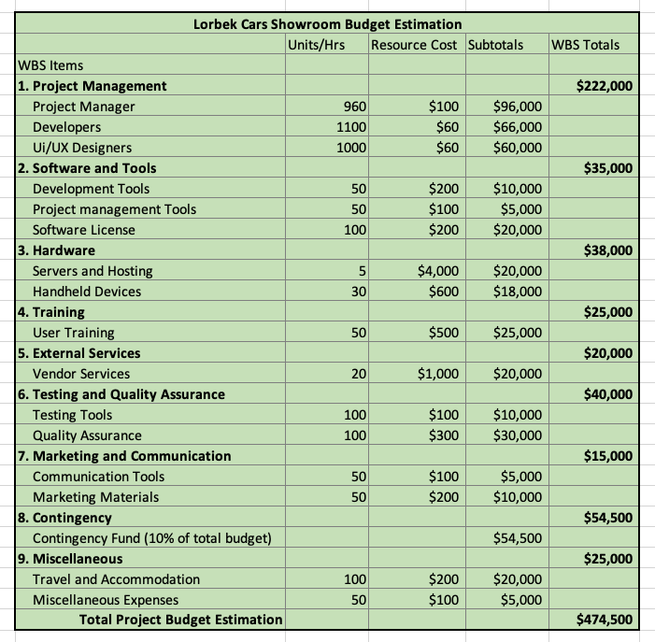
Budget Allocation

Slide 11
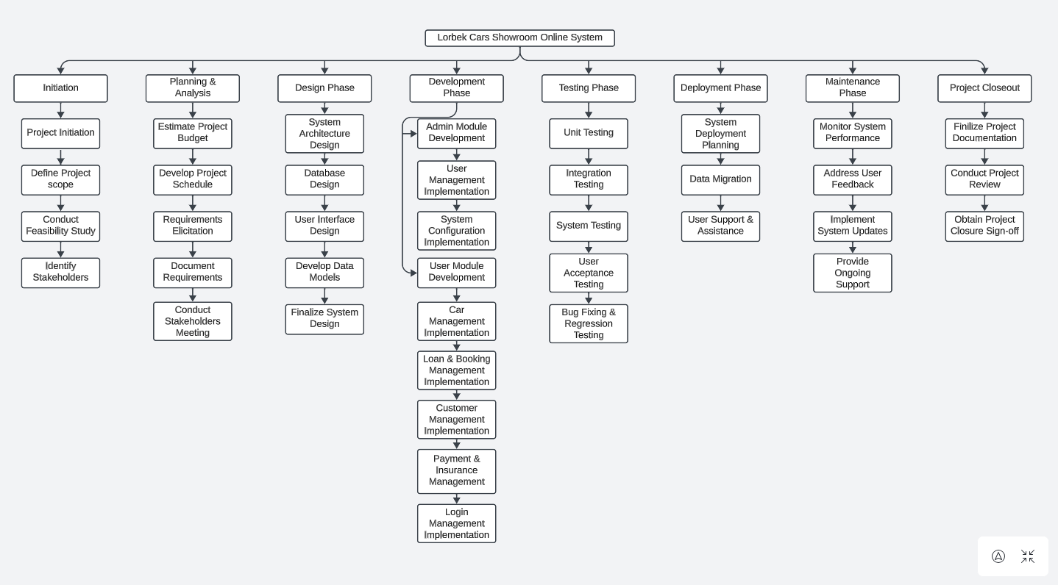
Work Breakdown Structure

Slide 12
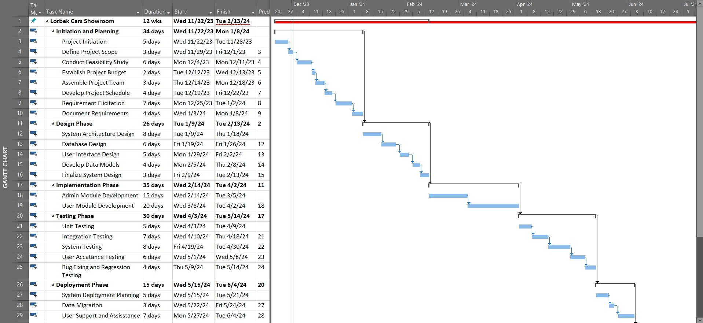
Gantt Chart

Slide 13
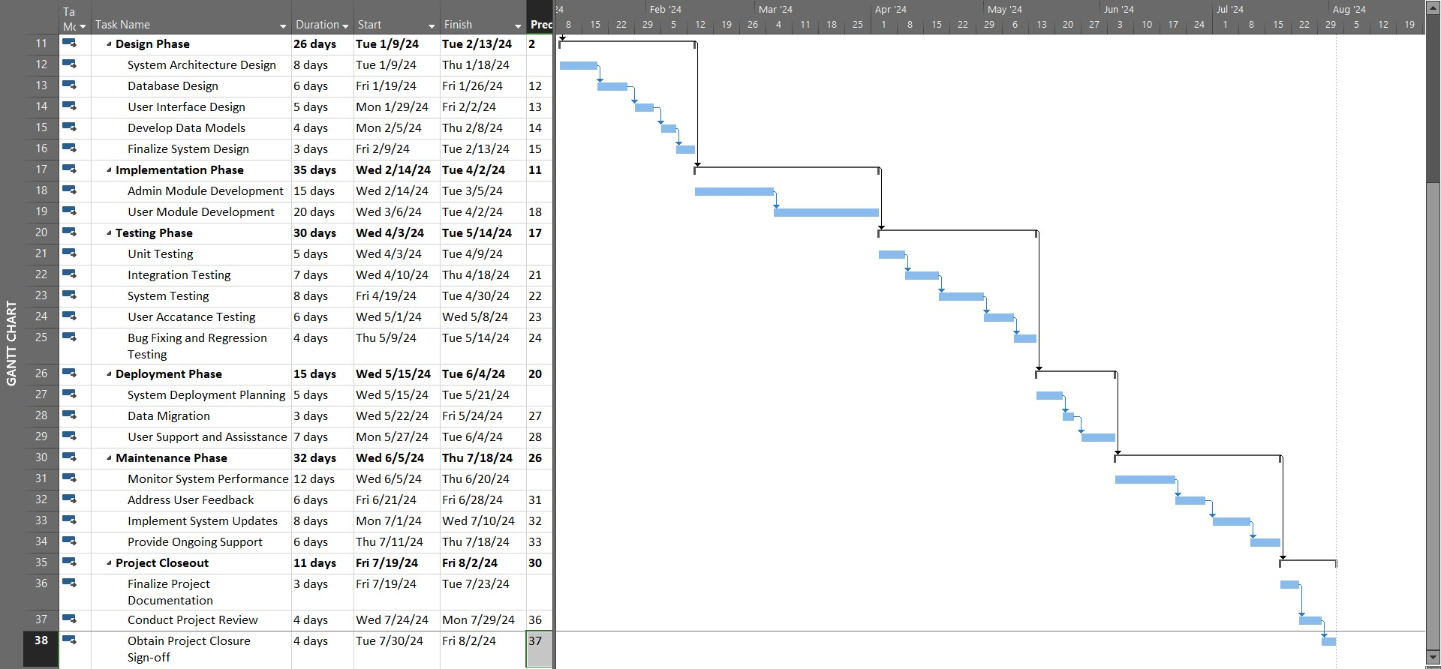
Gantt Chart

Slide 14
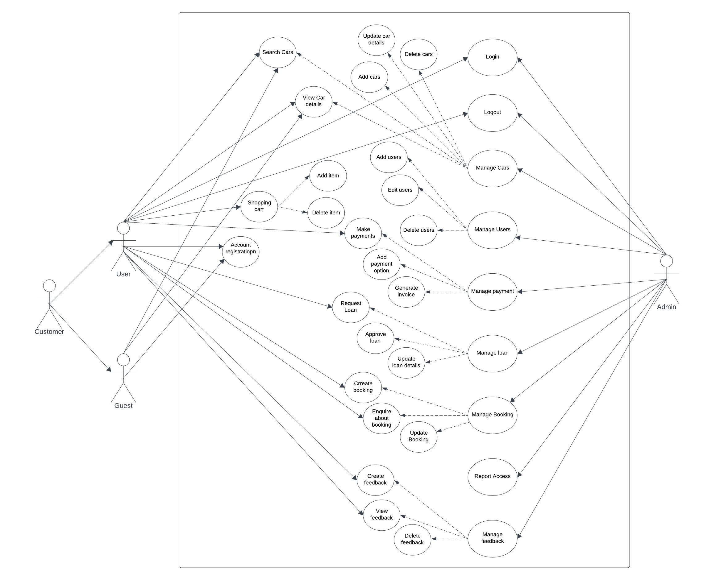
Use Case Diagram

Slide 15
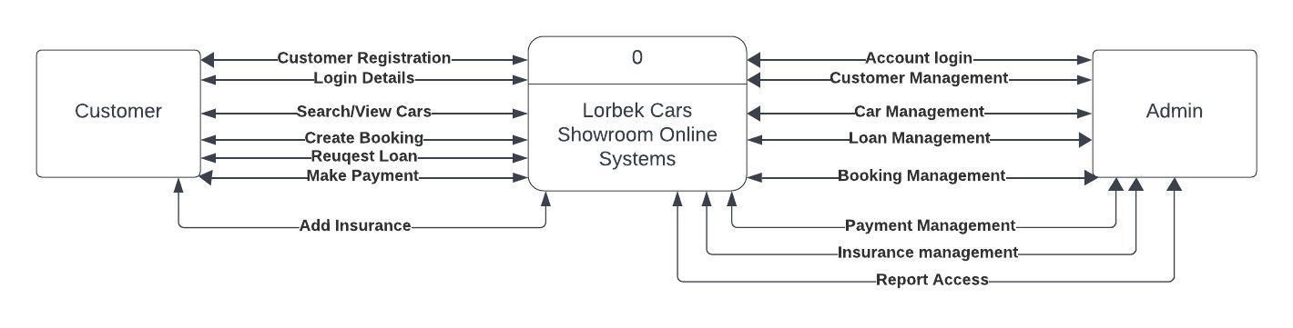
DFD Level 0

Slide 16
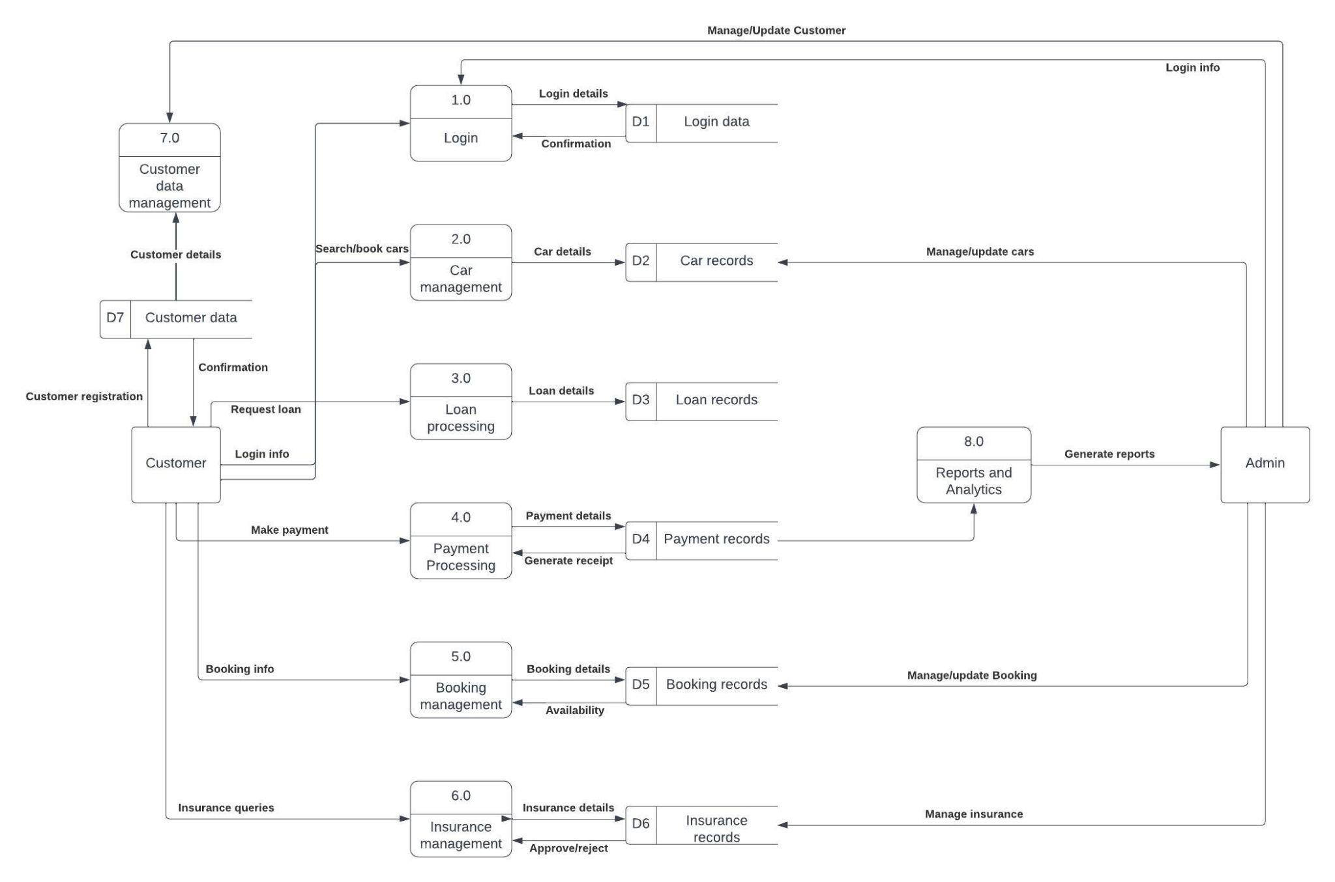
DFD Level 1

Slide 17
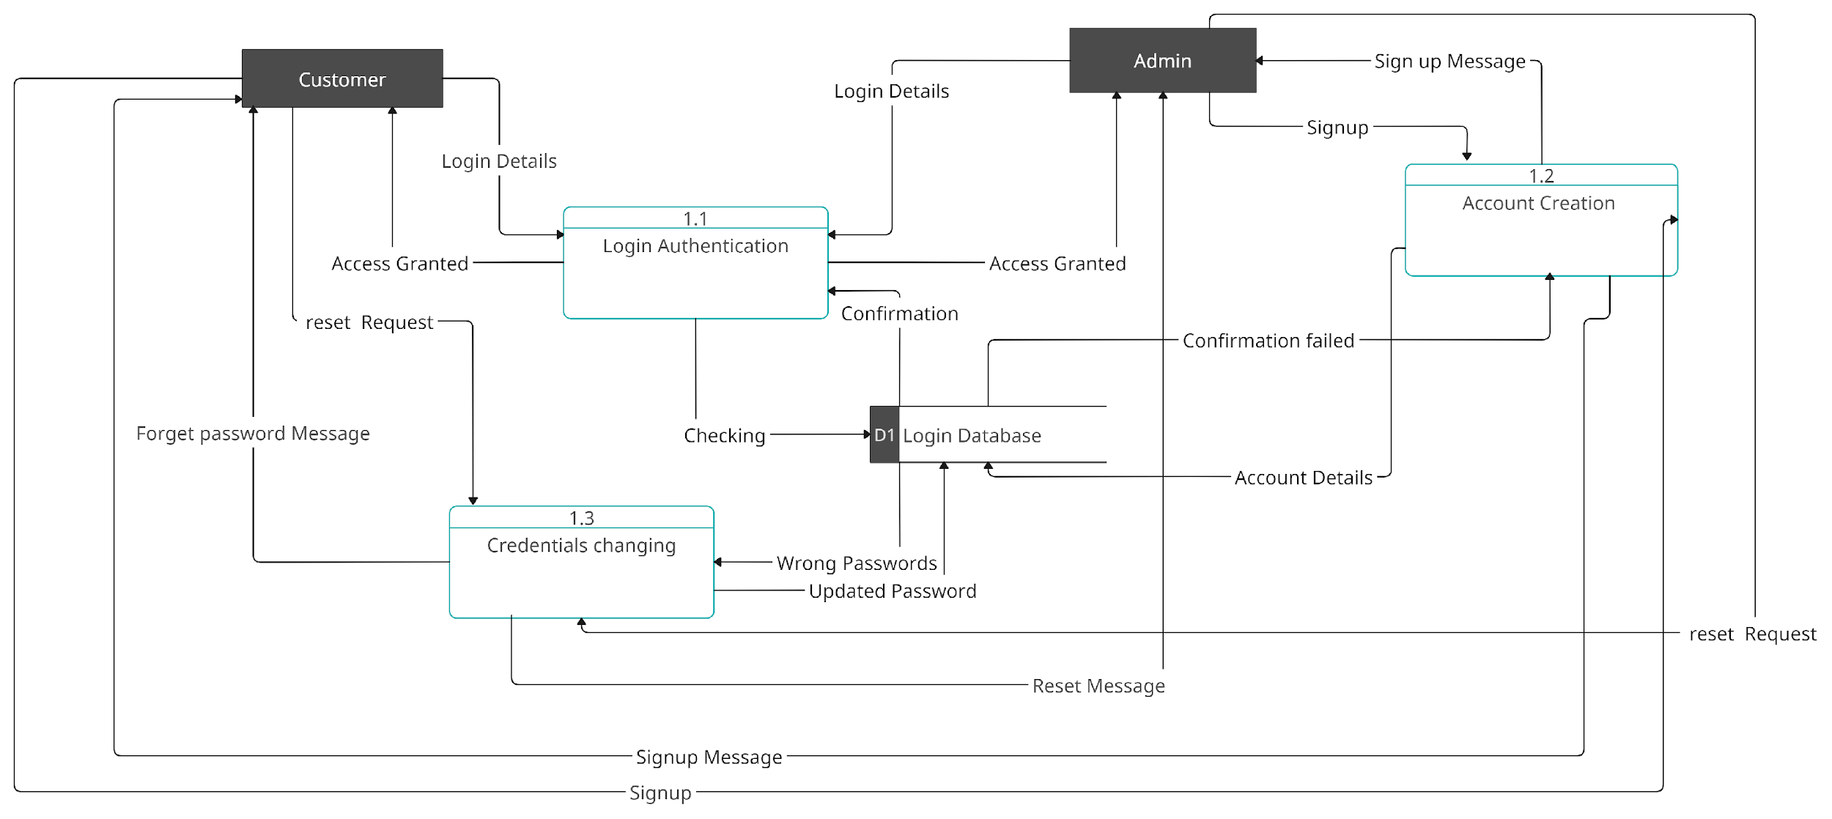
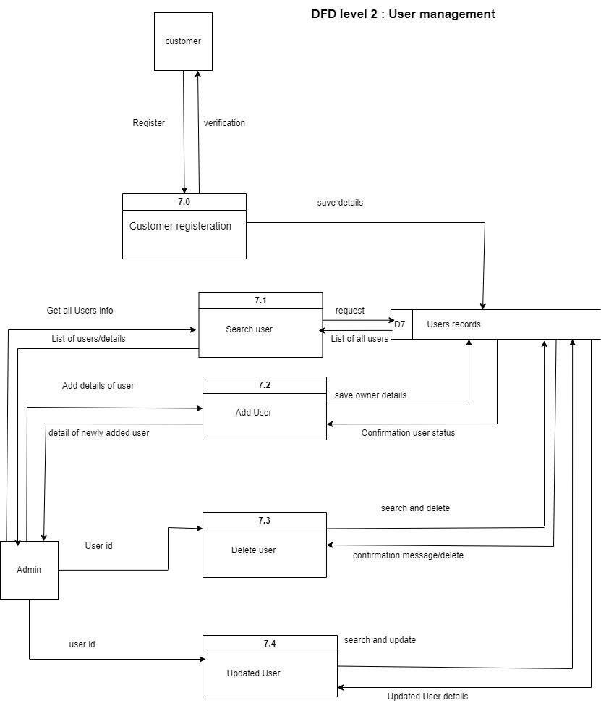
DFD Level 2
Customer Management
User Login

Slide 18
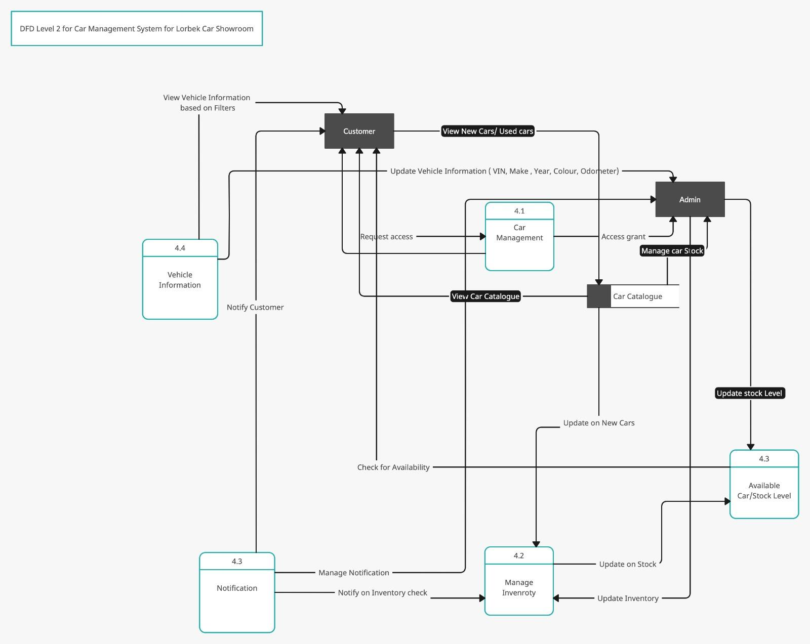
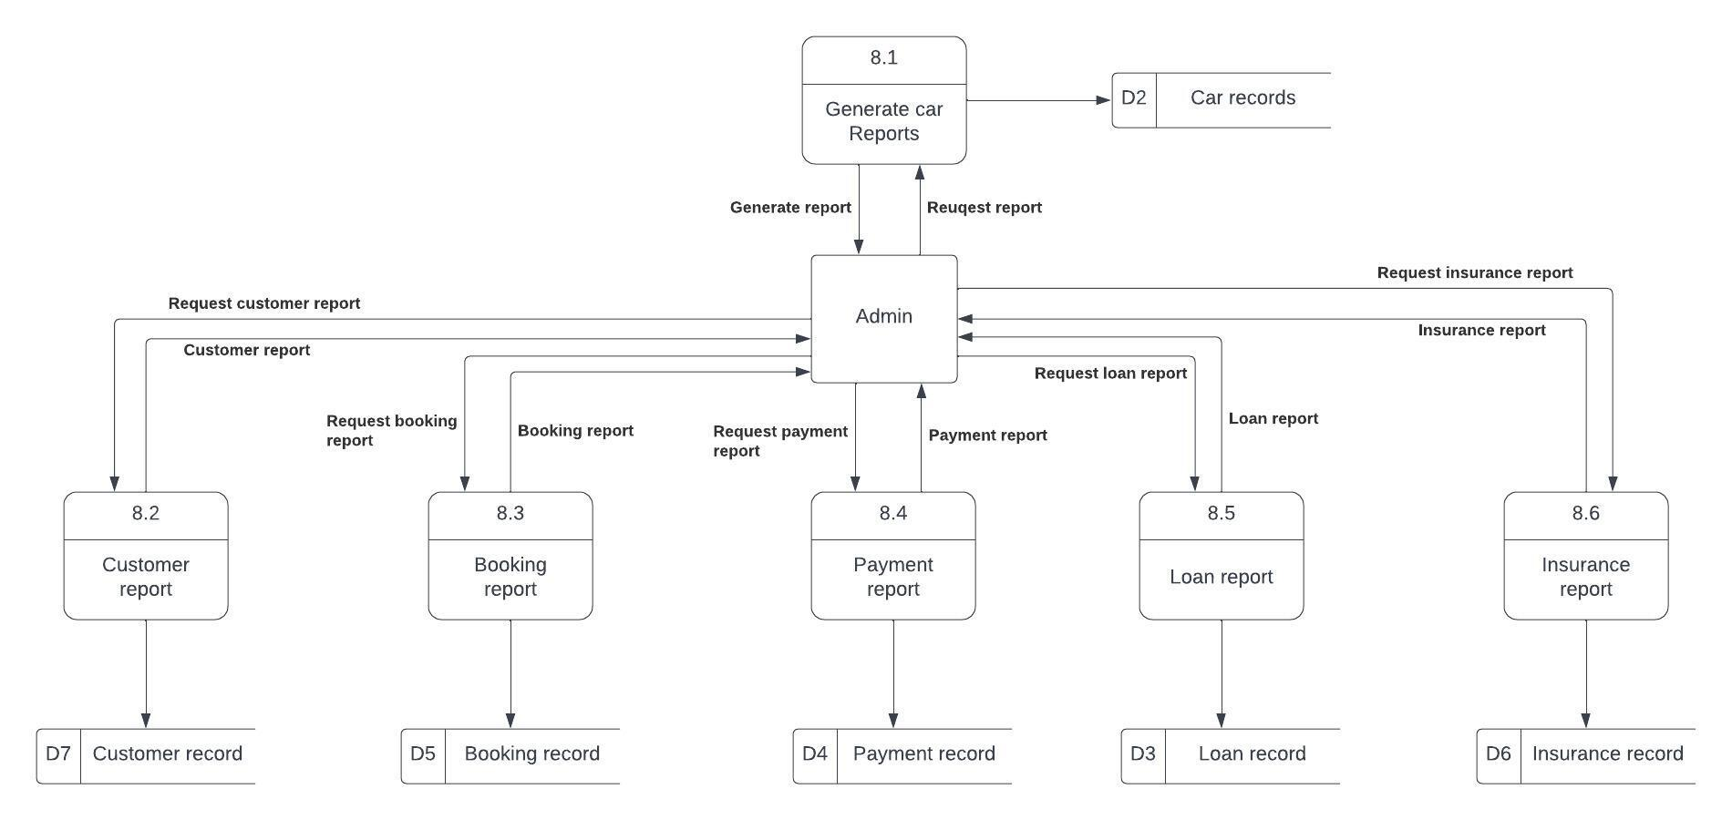
DFD Level 2
Car management
Report Generation and Access

Slide 19
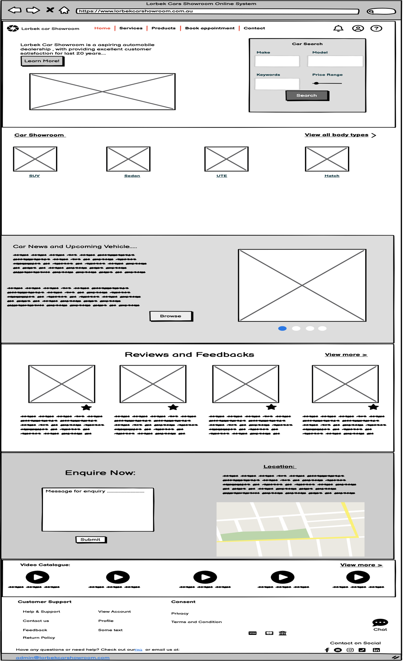
User Storyboard

Slide 20
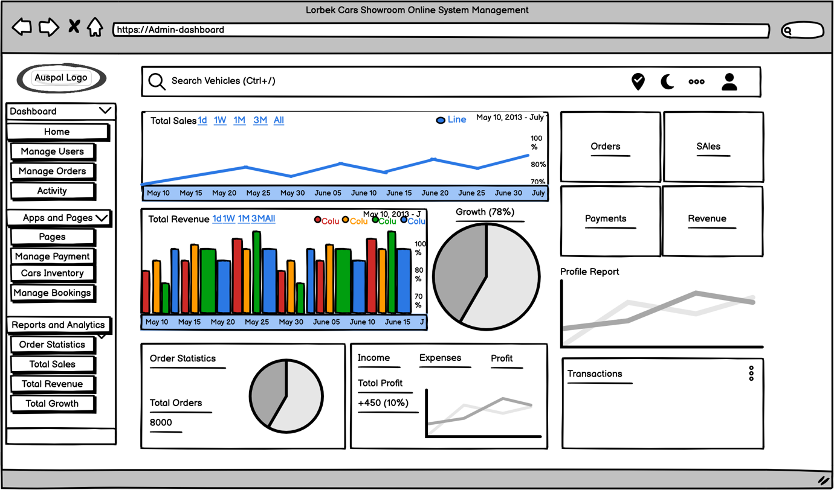
User Interface Design

Slide 21
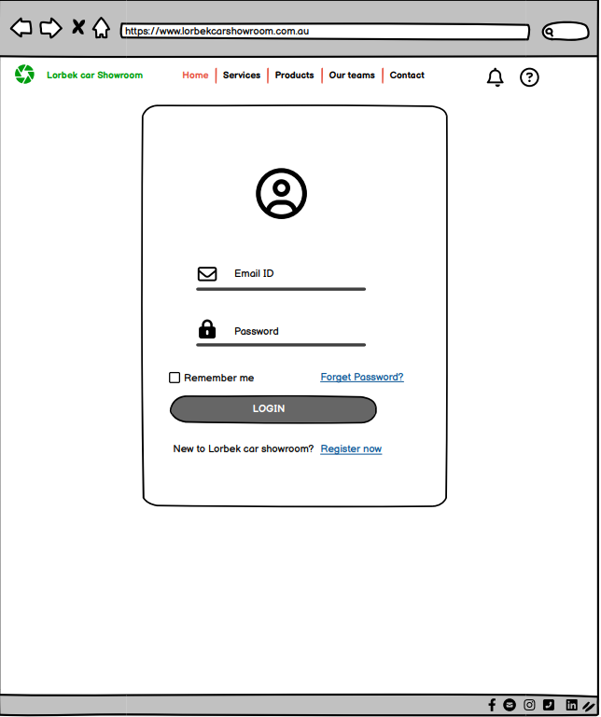
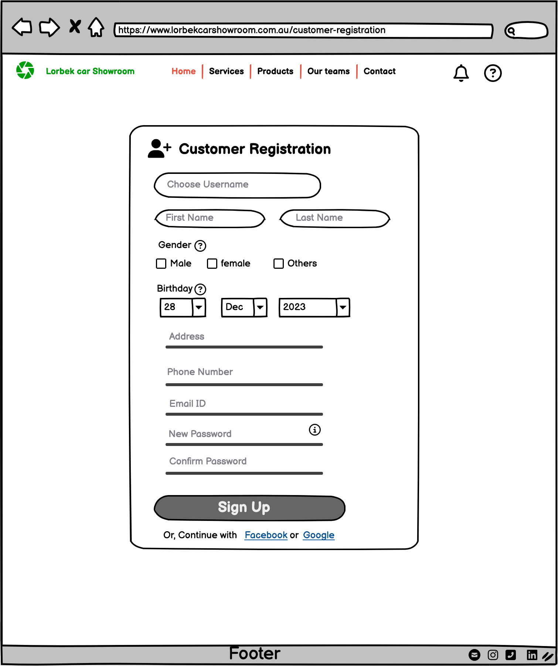
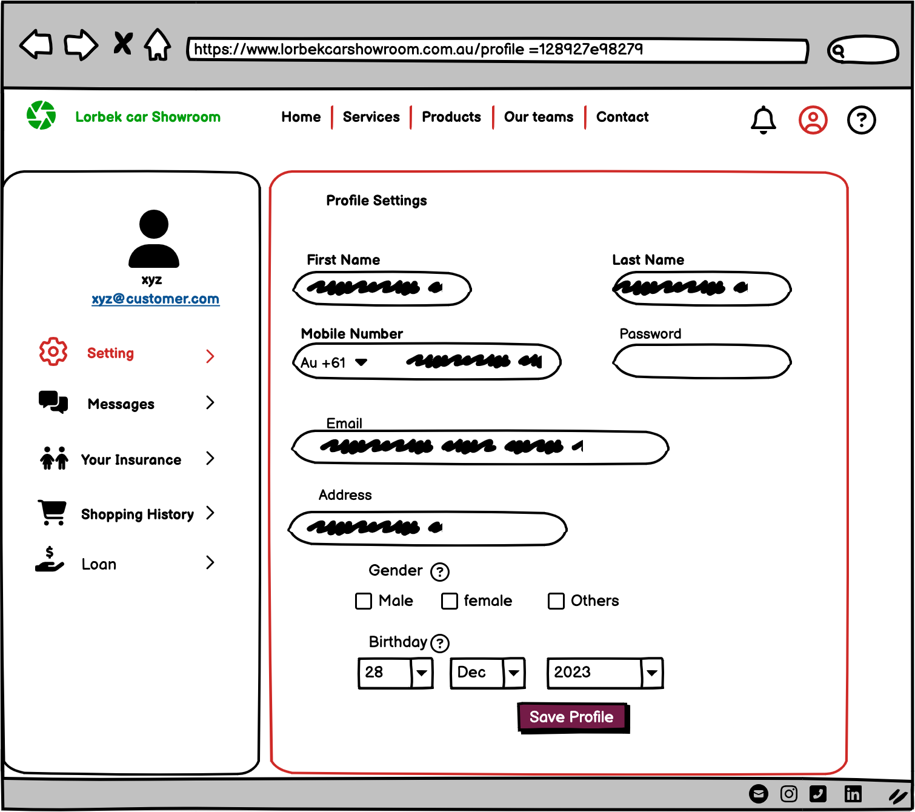
User Interface Design

Slide 22
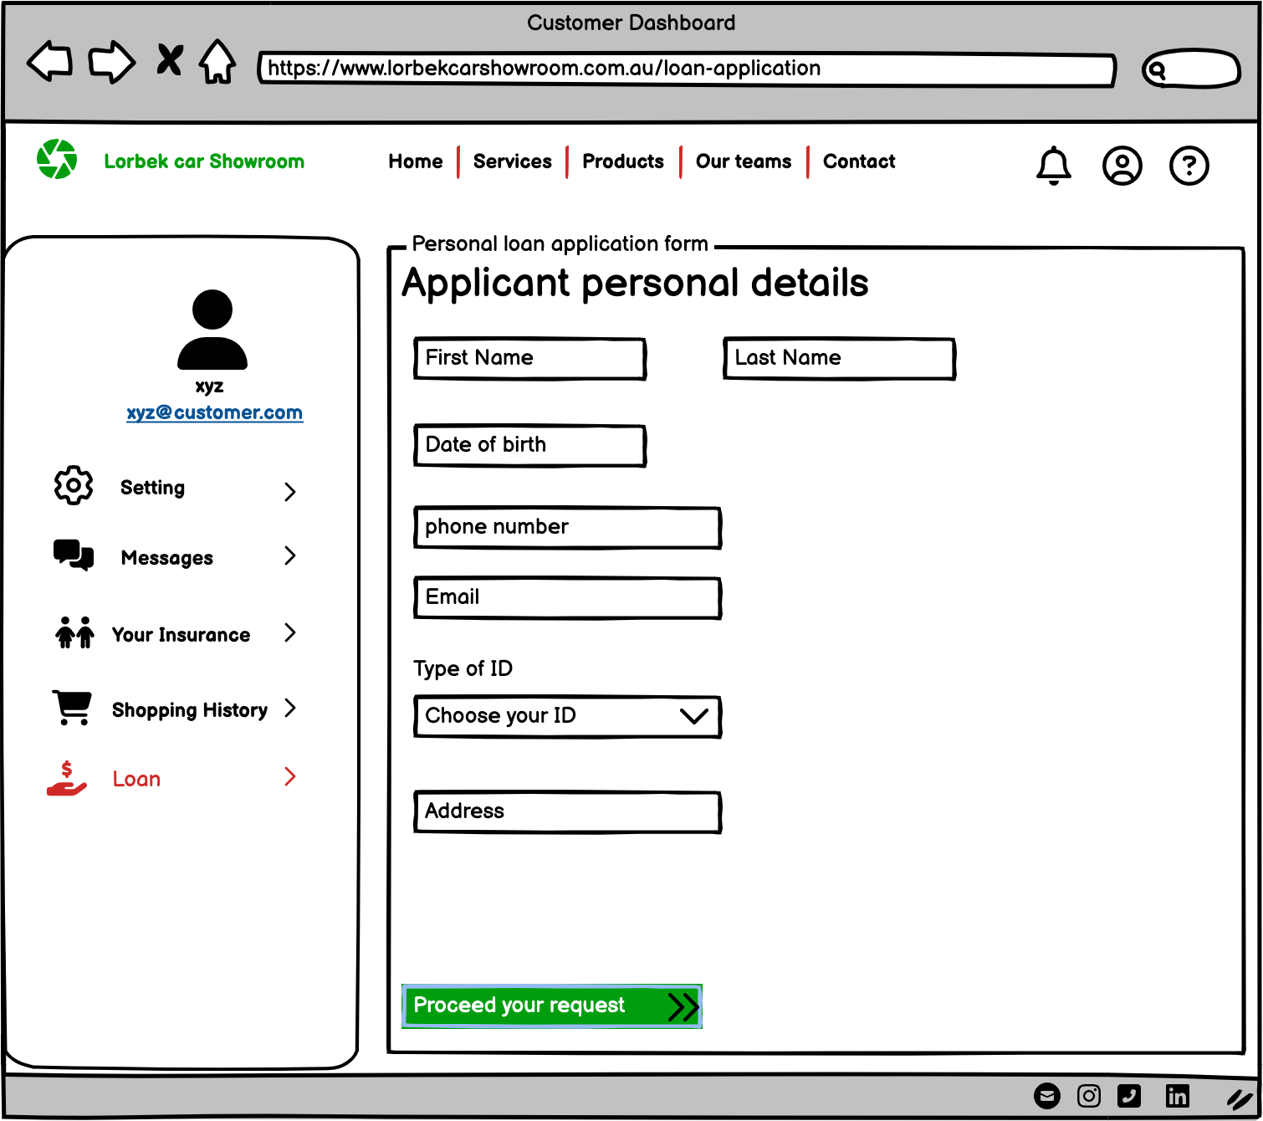
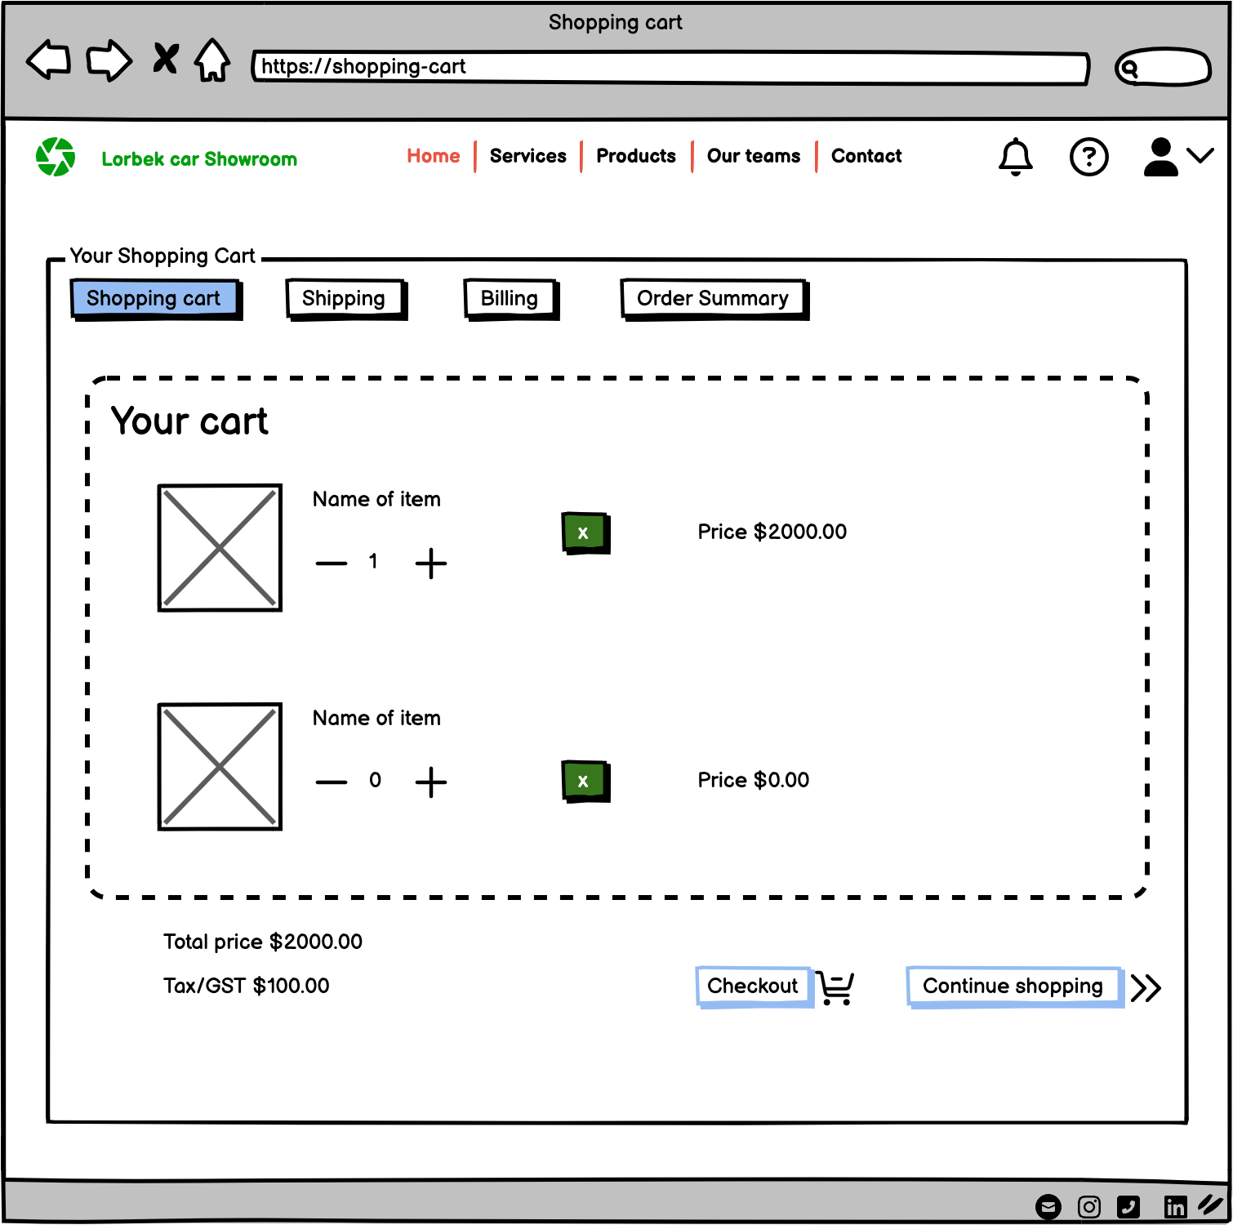
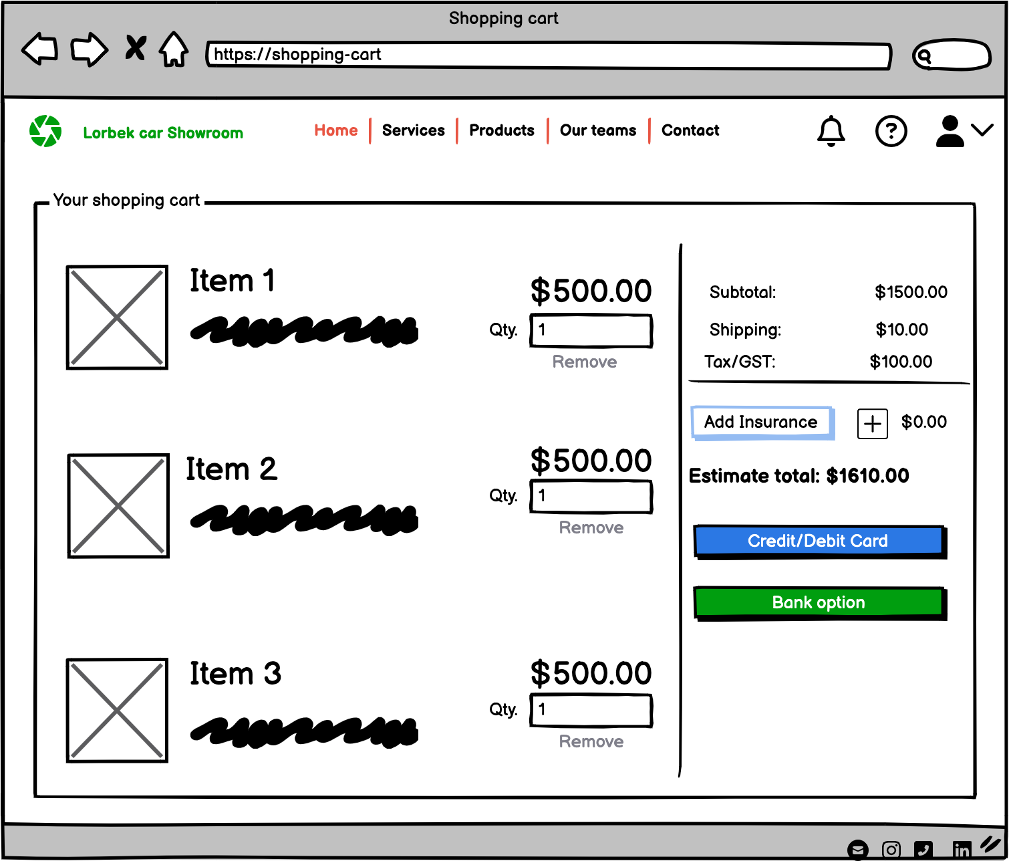
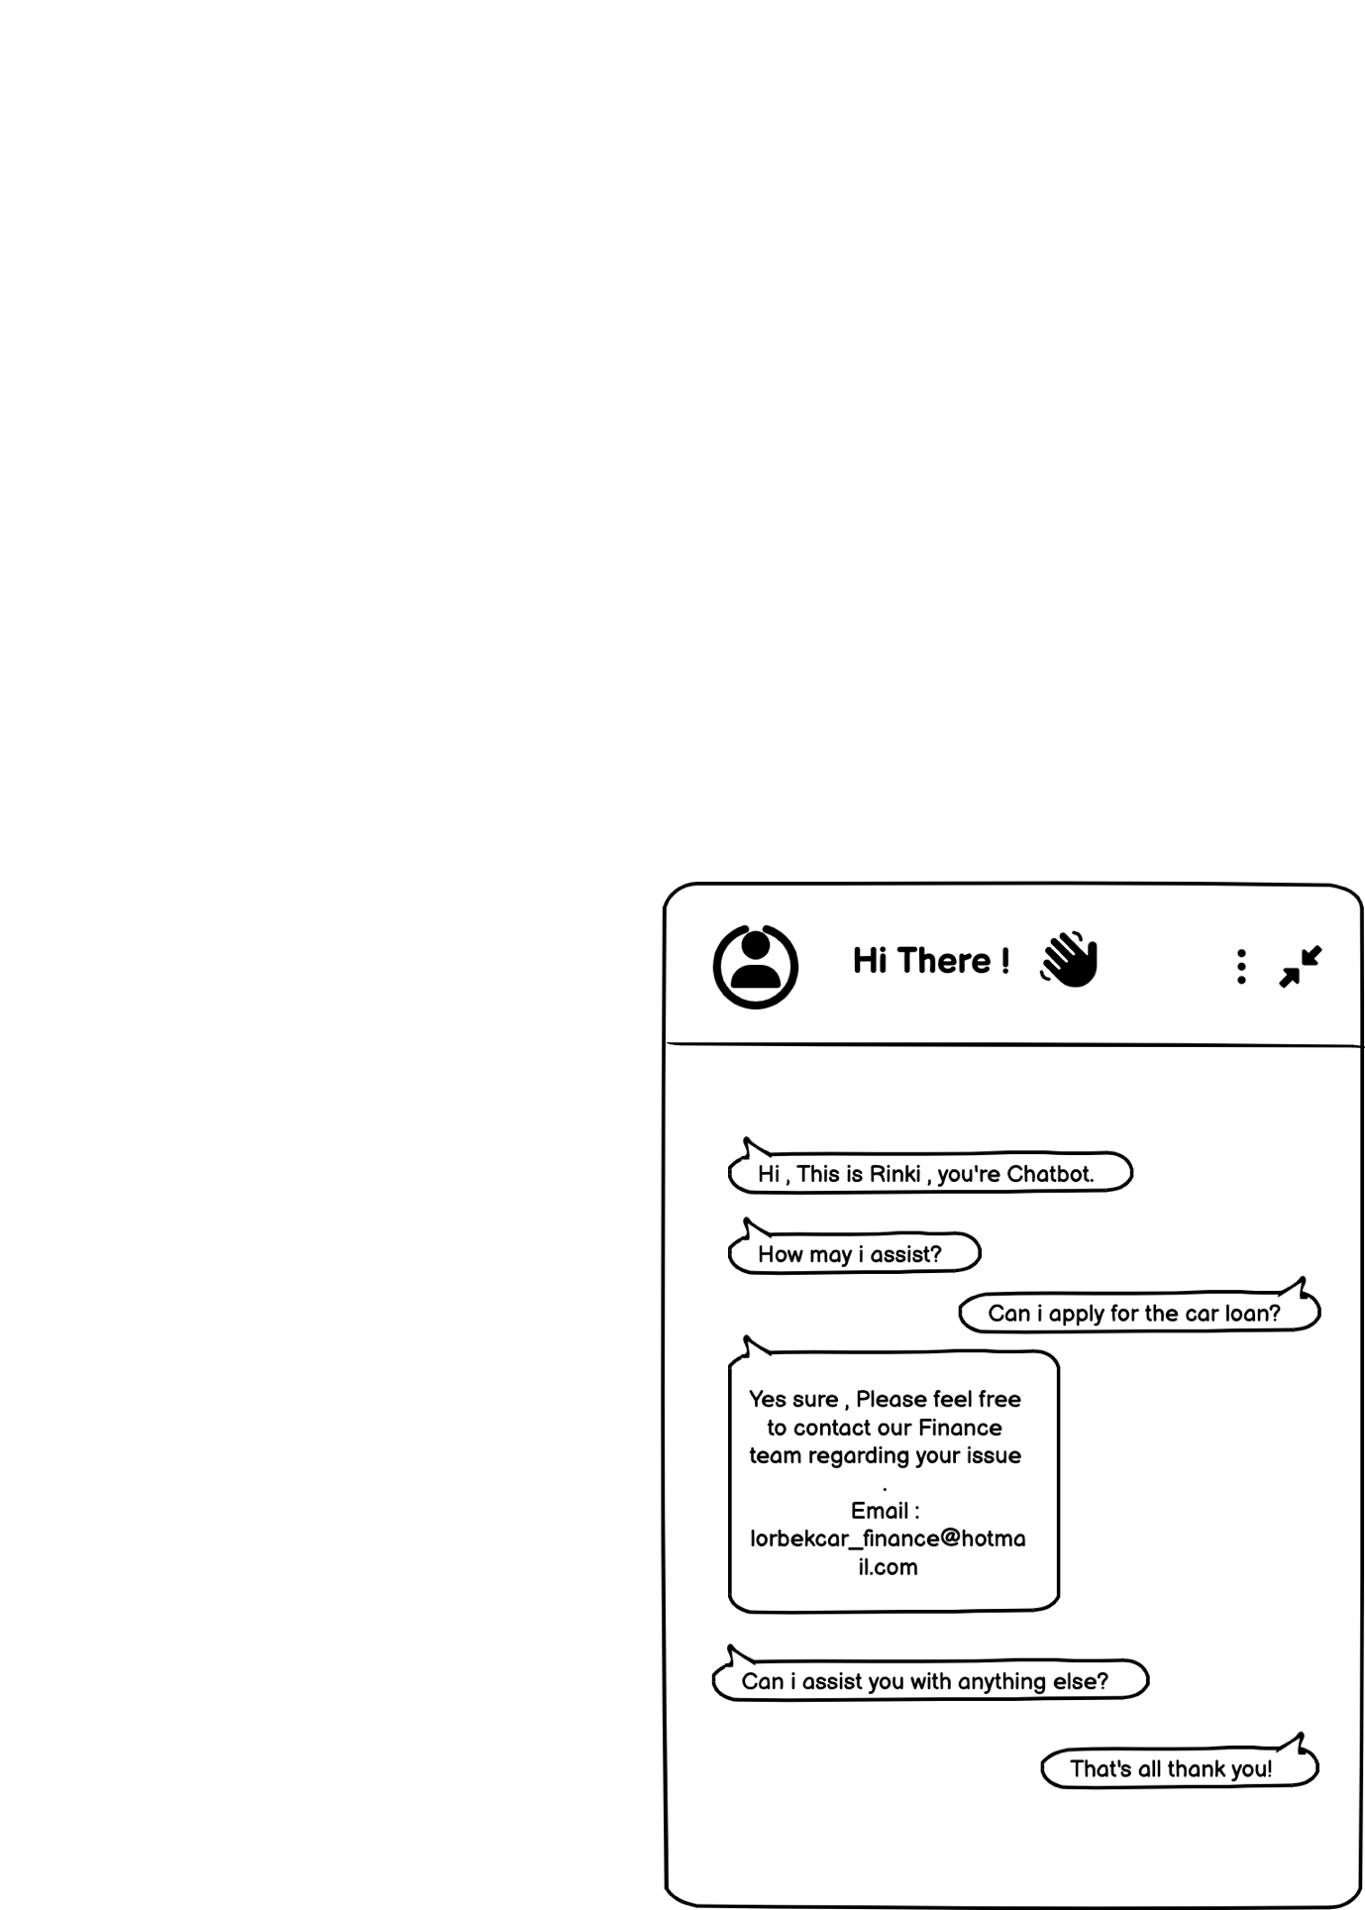
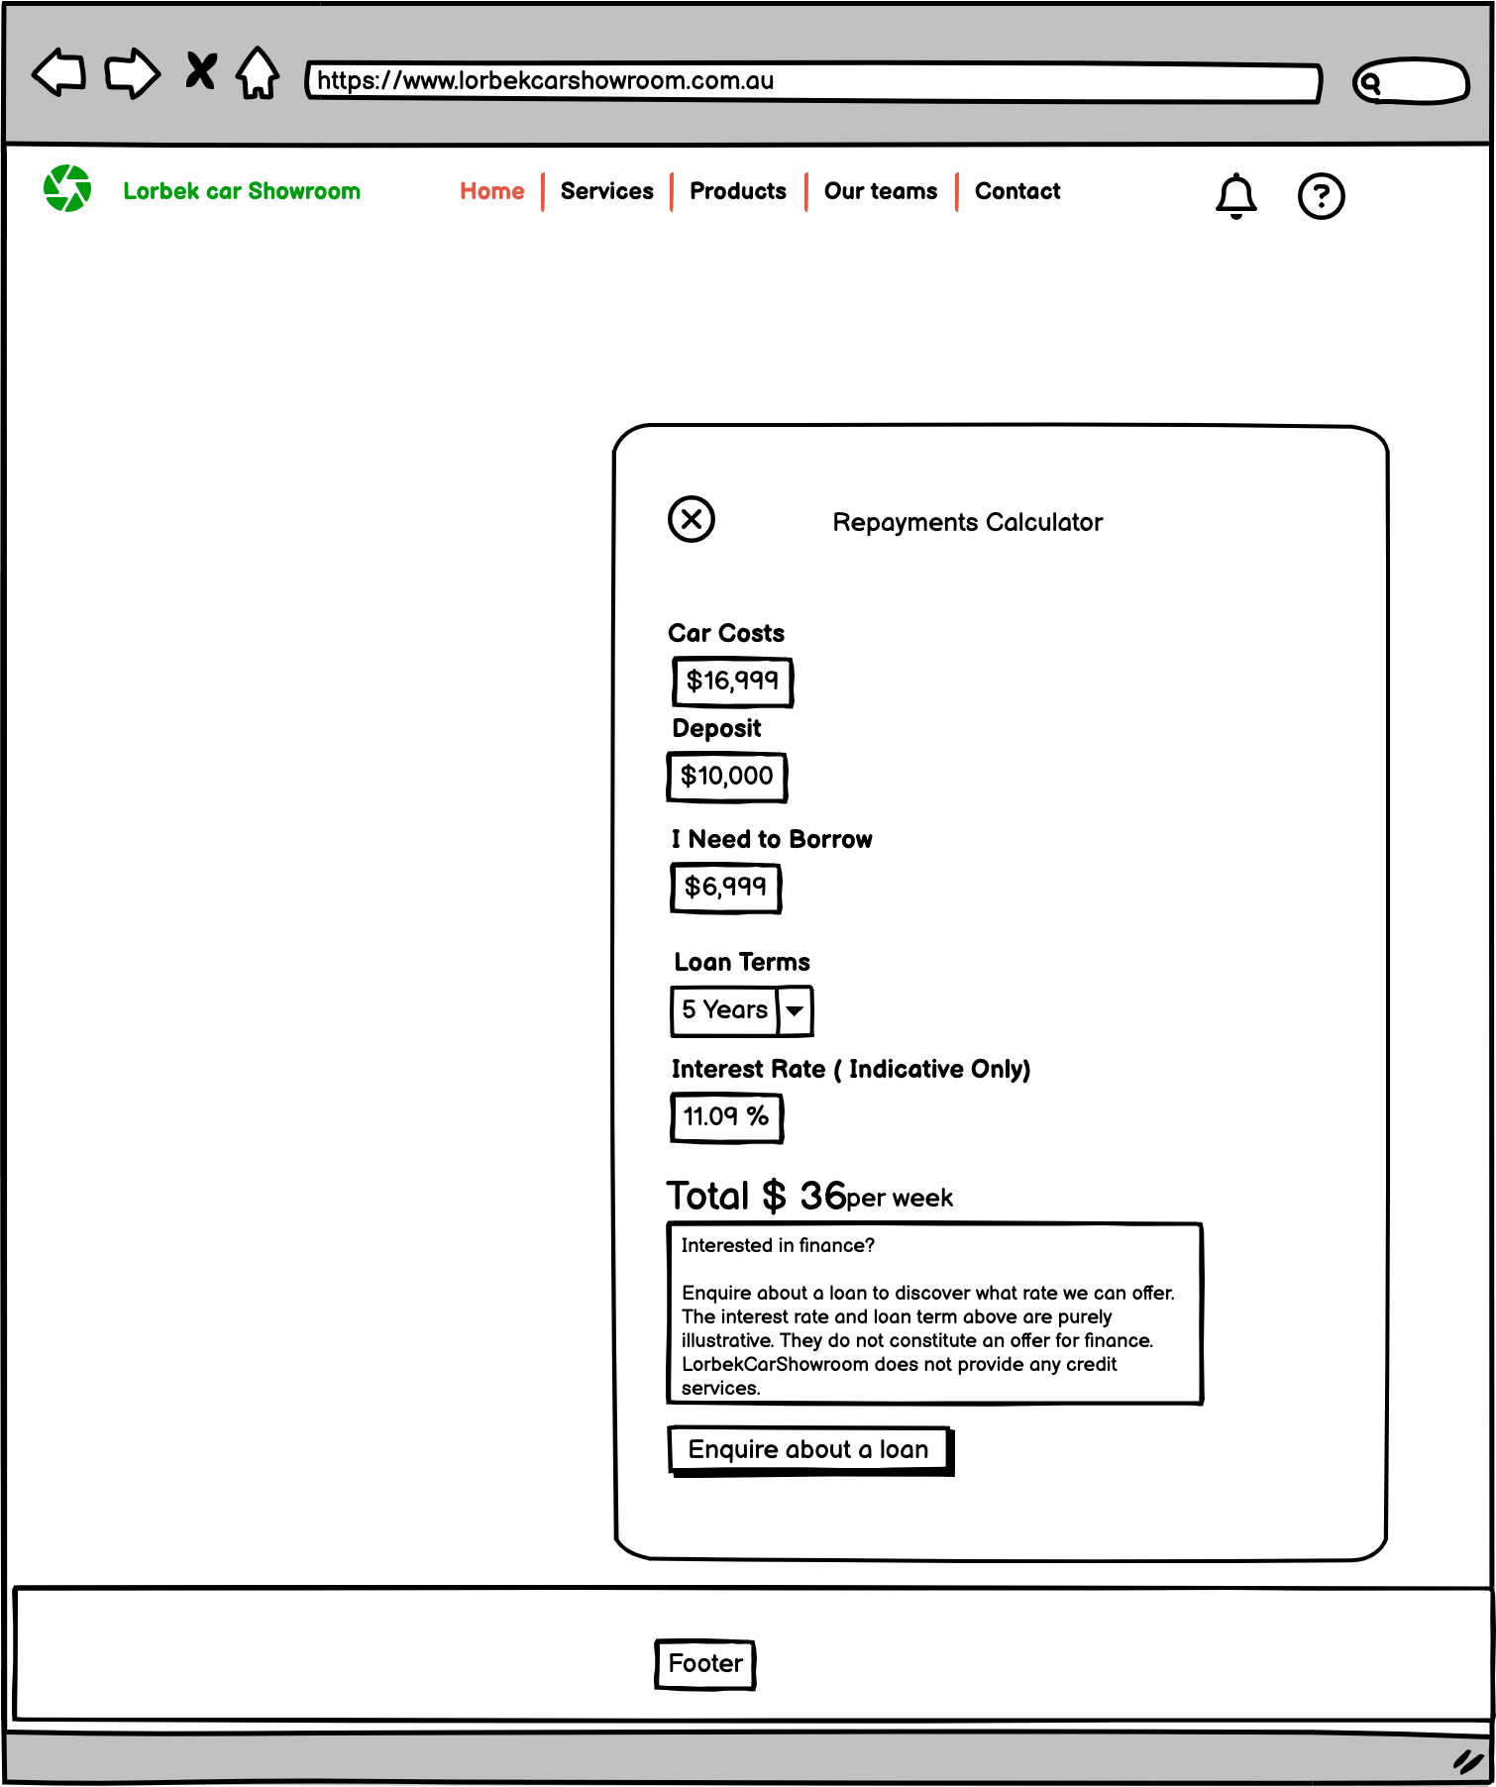
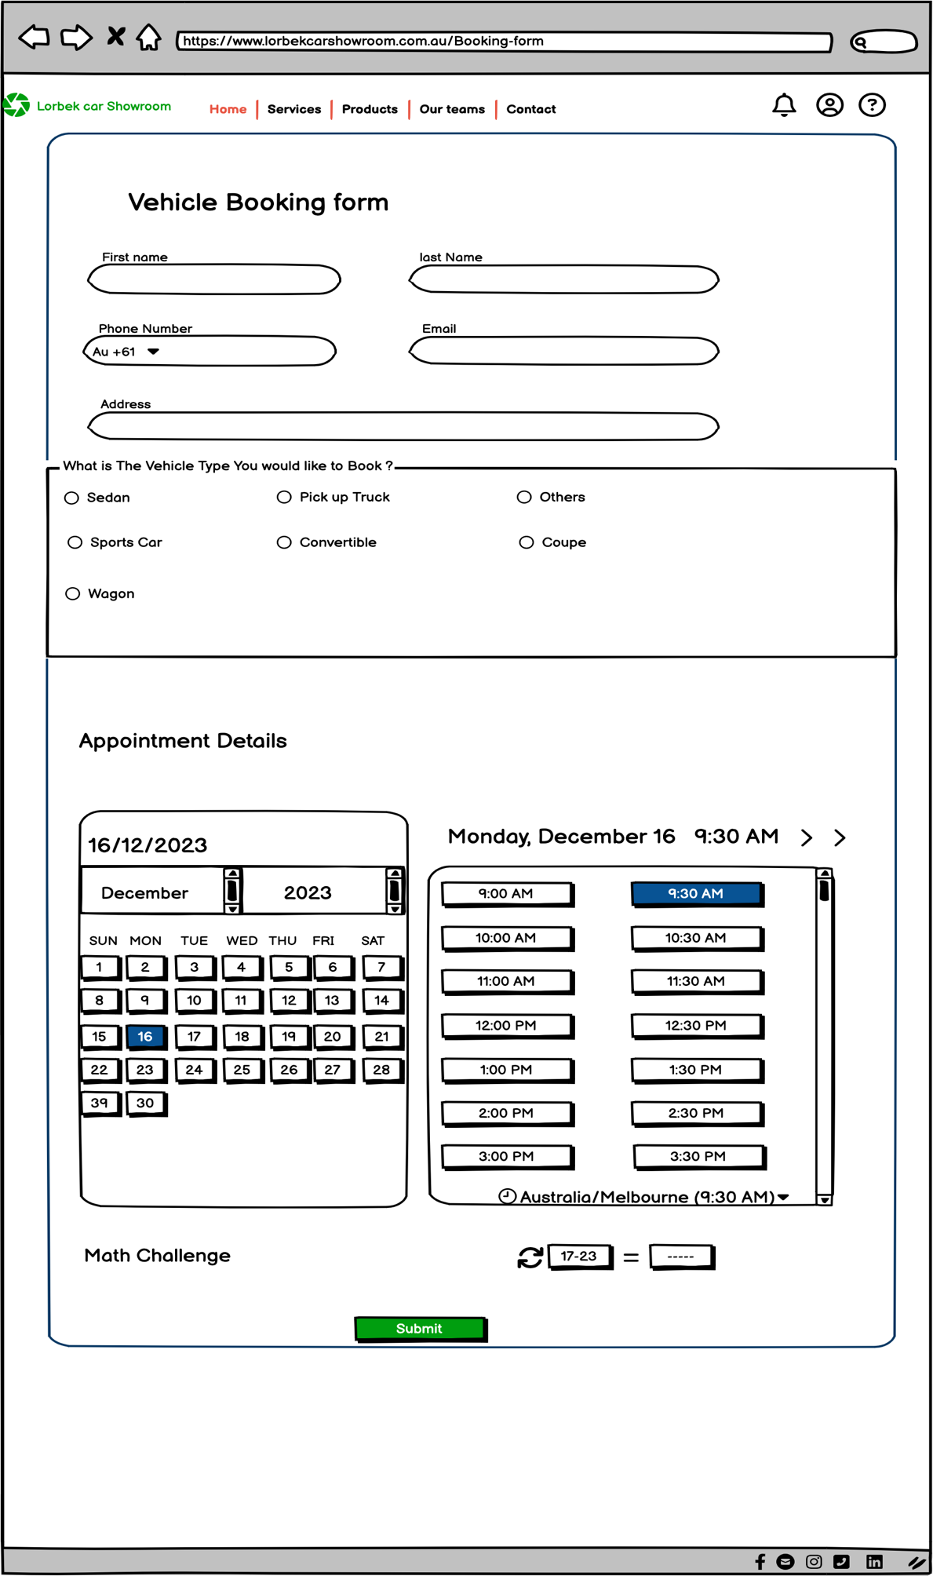
User Interface Design

Slide 23
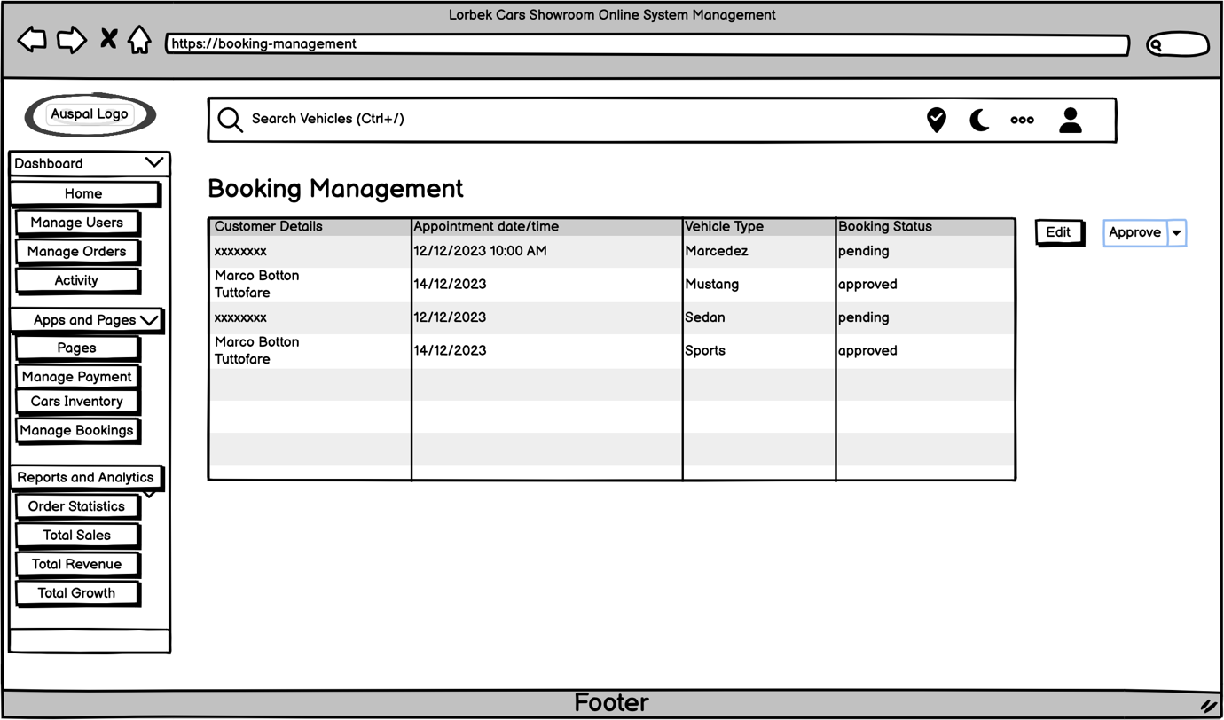
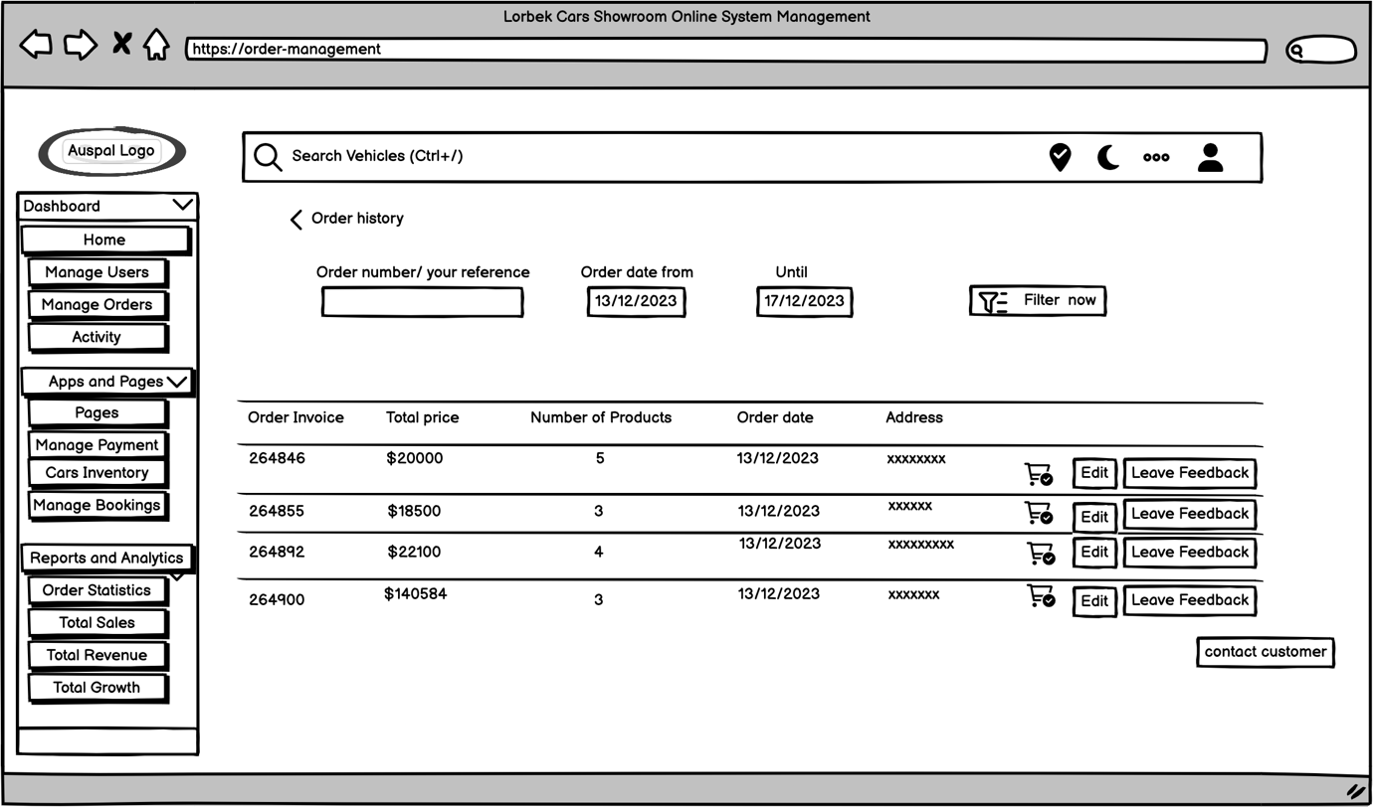
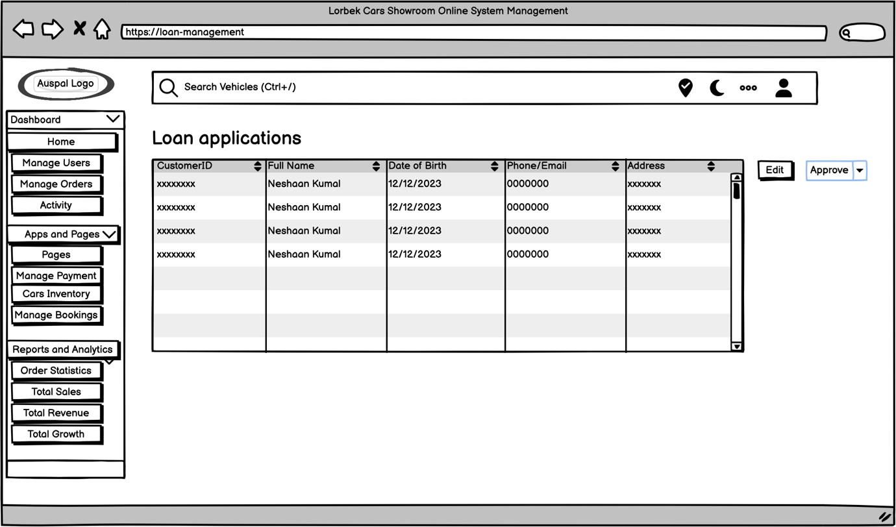
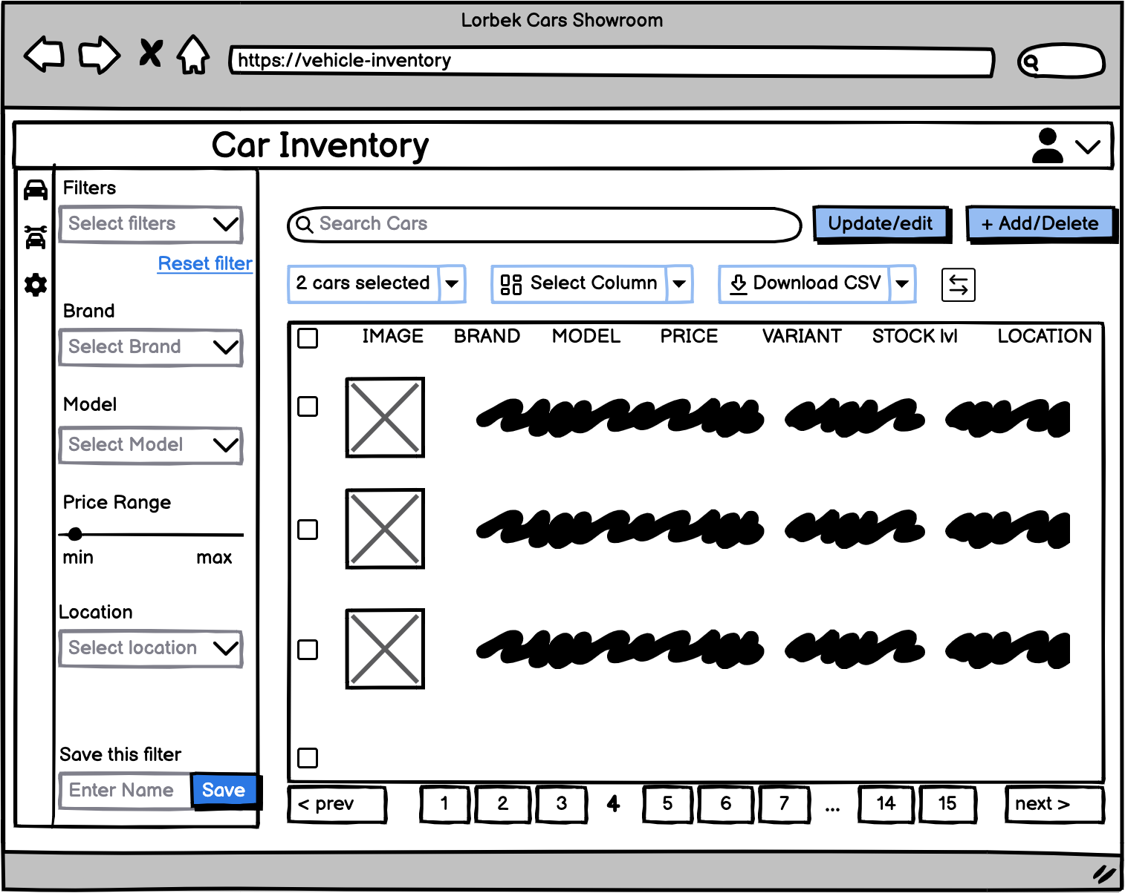
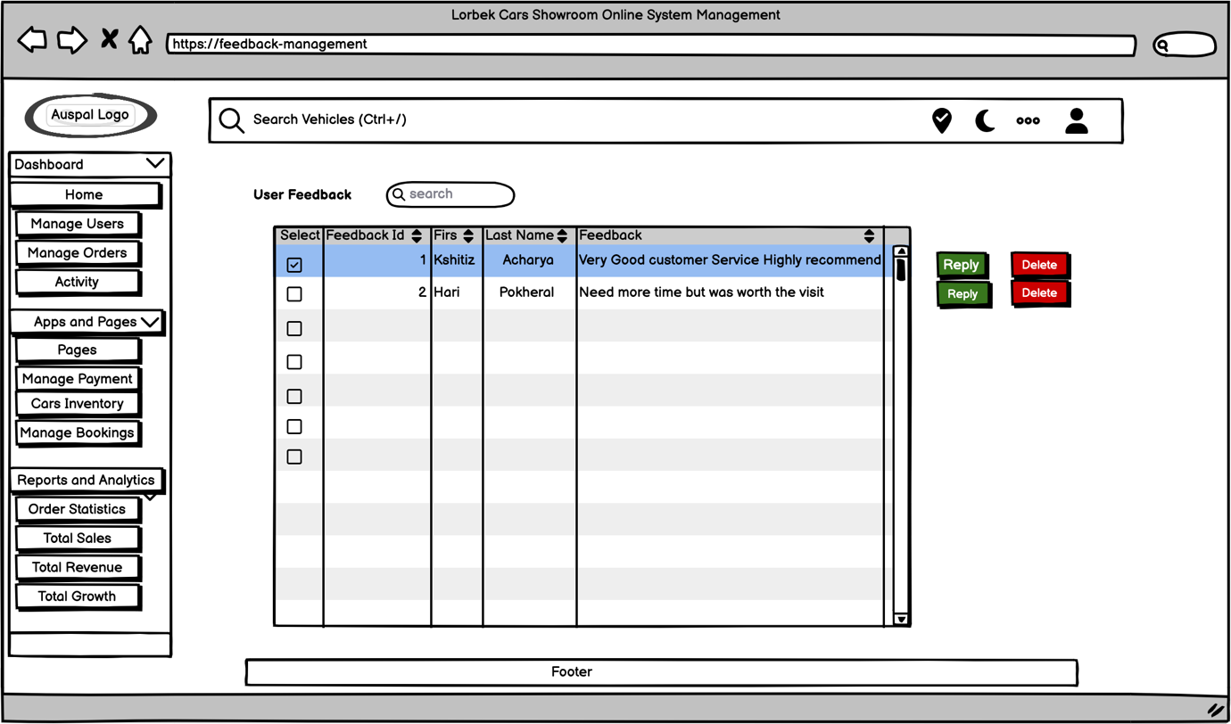
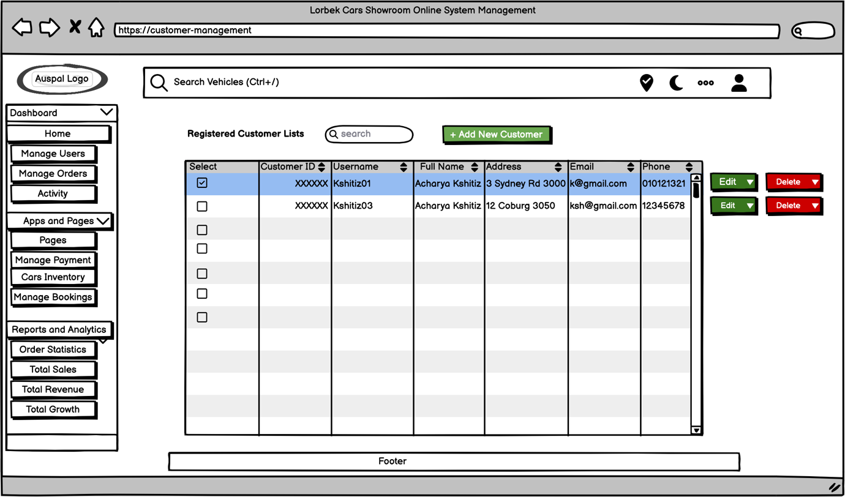
User Interface Design

Slide 24
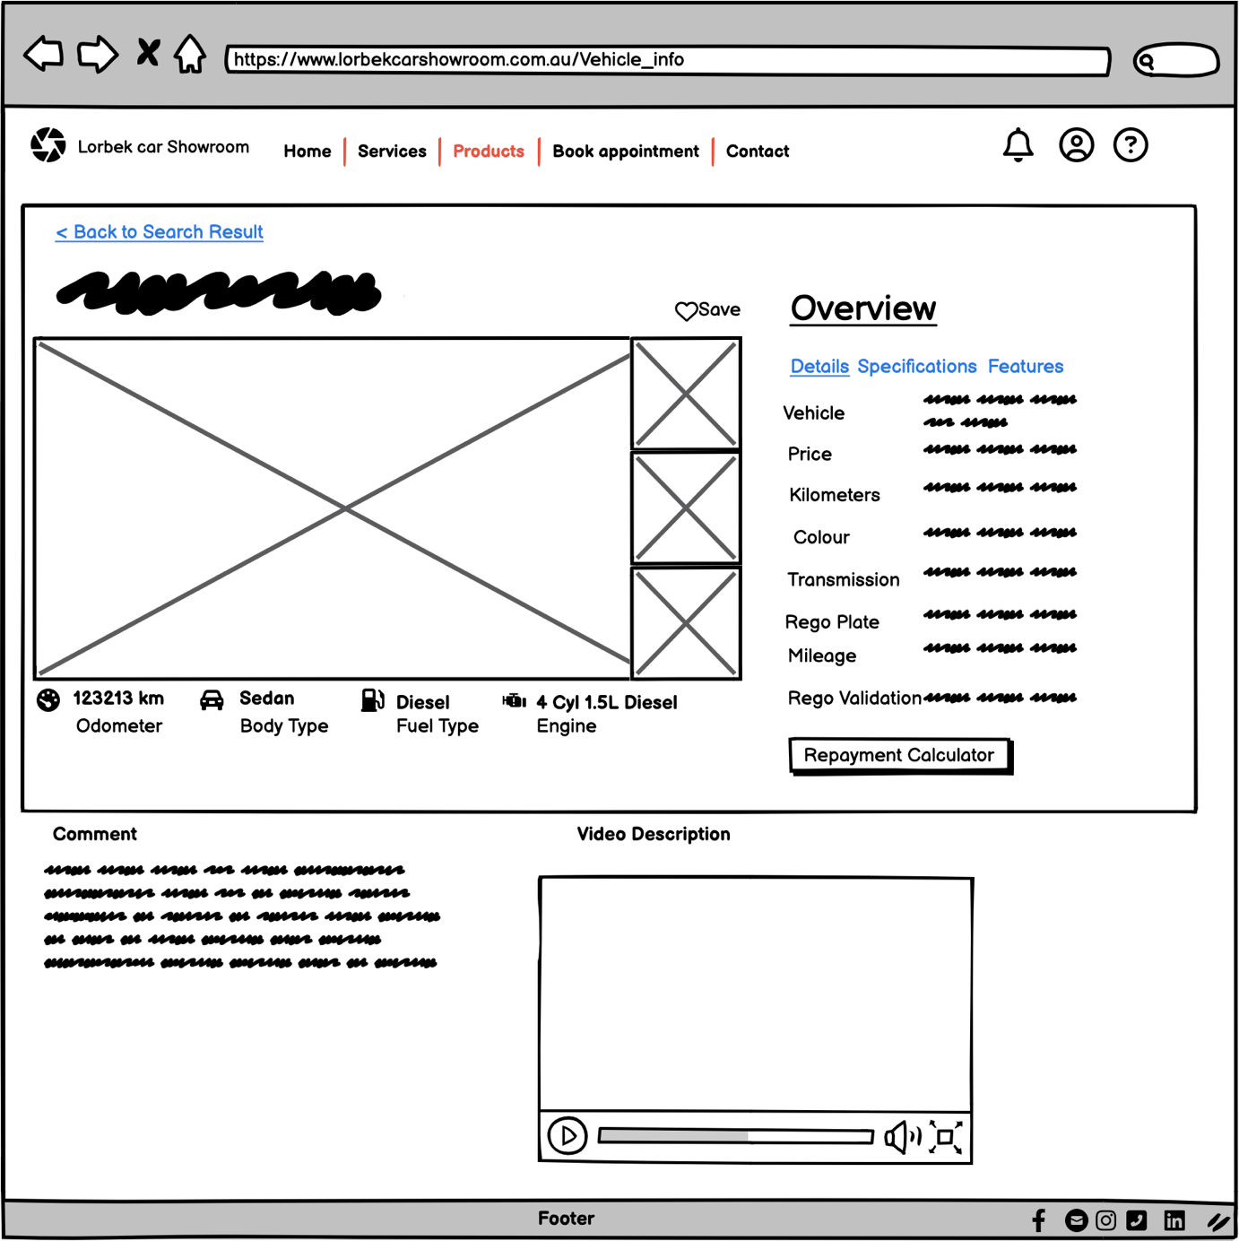
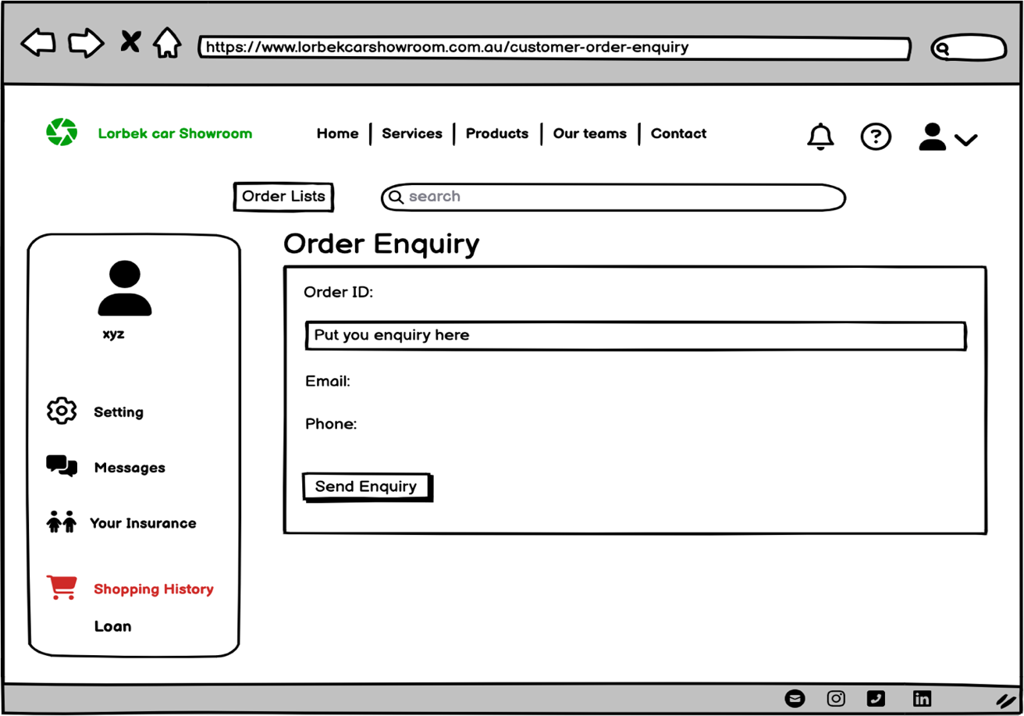
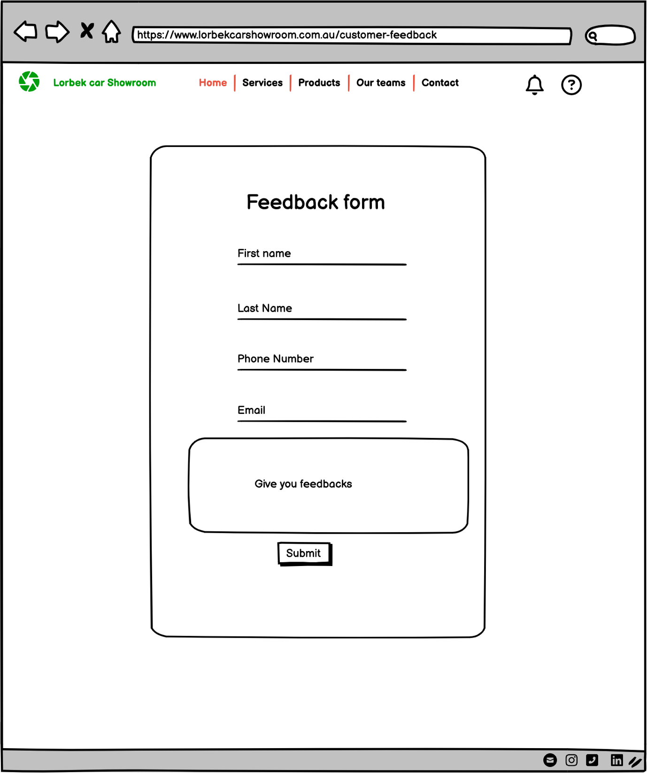
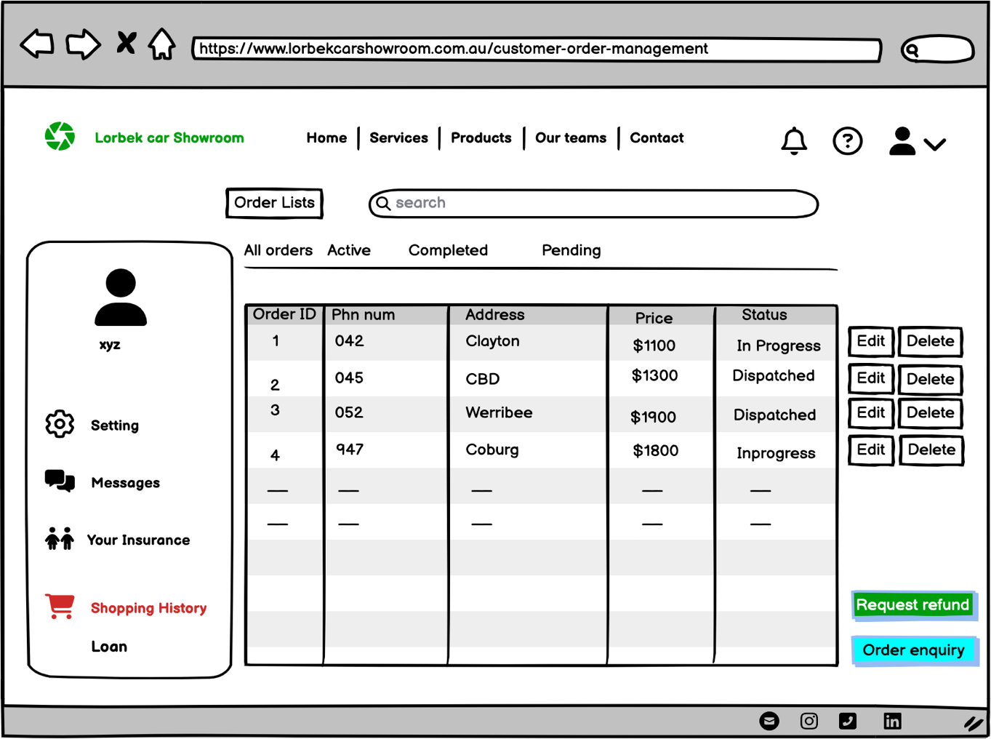
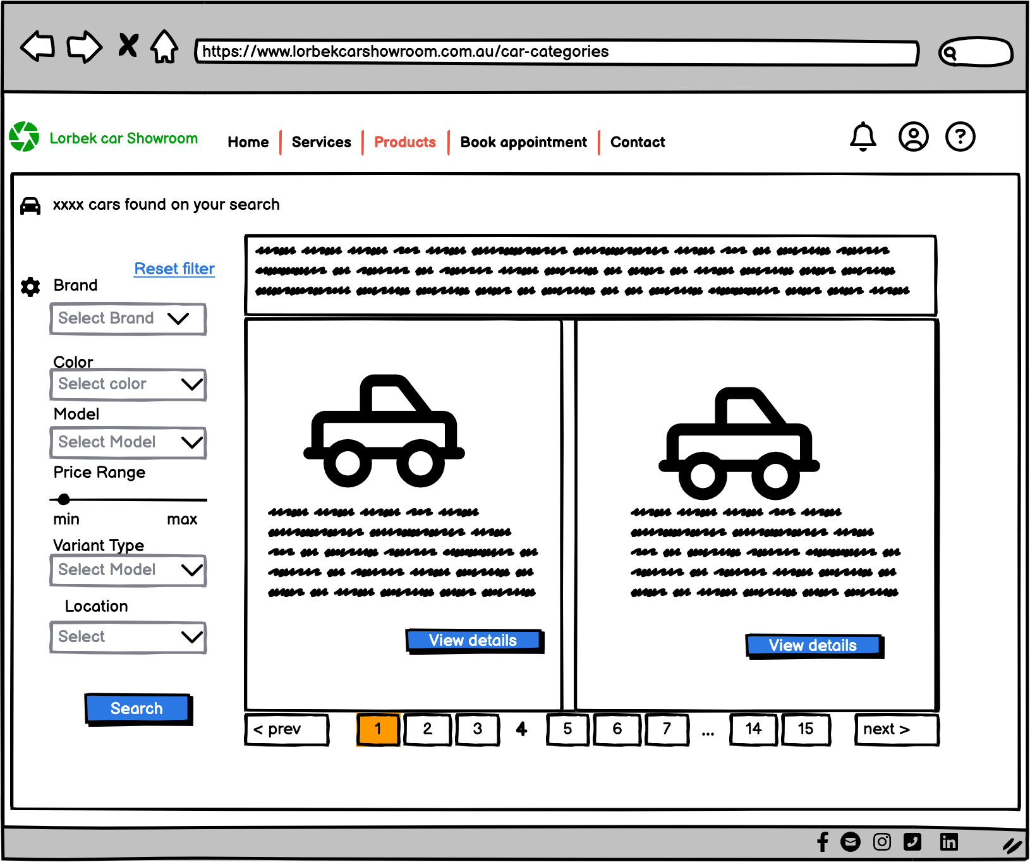
User Interface Design

Slide 25
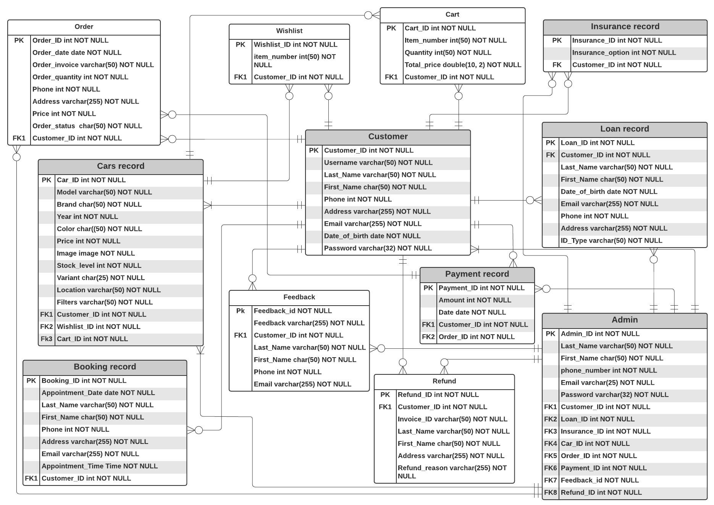
Entity Relationship Diagram

Slide 26
Test Plans
Performance testing
Validation testing
Unit testing
Memory leak testing
System testing
Acceptance testing

Slide 27
Data Encryption and Anonymization
Data Encryption
Client data
Payment information
Data Anonymization
Customer data
Transaction history
User Authentication
Exported reports

Slide 28
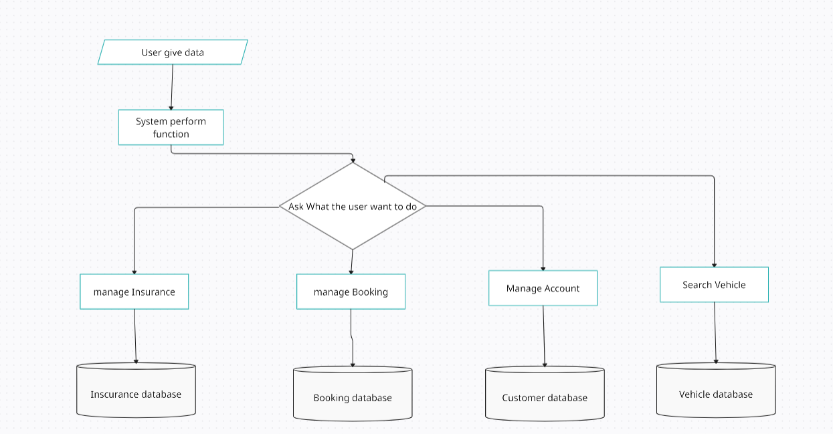
Data Protection and Impact Assessment

Slide 29
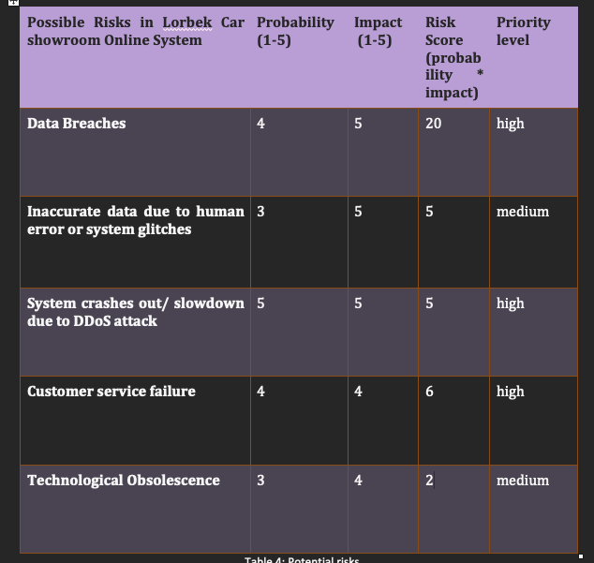
Potential Risks

Slide 30
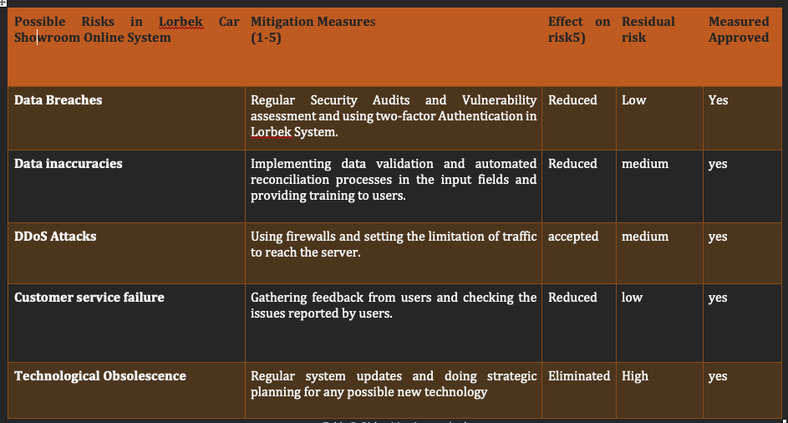
Risk Mitigation Methods

Slide 31
Thank You!
Any Questions?

